Slide 1

Civilian Deaths in Conflicts 1989-2020
MSDA 673
Matthew Harrington

Slide 2
The 3-Minute Story
UCDP Introduction
Rwanda
Percentile Trends
What we are and are not considering
Notes:
Today I will be presenting on my work visualizing part of the Uppsala Conflict Data Program’s latest published data set. The UCDP is a data collection program based out of a university in Sweden that has been tracking armed conflicts around the world for almost forty years.
When we look at the portion of the UCDP’s data concerning civilian deaths, there is one stand out event that warps the entire set around it: the Rwandan Genocide. Nothing else comes close, not 9/11, not the post-Yugoslavia conflicts, not anything in the Middle East. There are decades with less civilian deaths than what occurred in Rwanda.
However, most armed conflicts in this time range had virtually no civilian deaths. The 50th percentile of conflicts had zero deaths while the 75th had one. The vast majority of armed conflicts do not involve civilians. But when things go wrong, they go very wrong.
Thus, it would be of great benefit to us if we can ascertain what can turn a normal conflict with few civilian deaths into one that has many. Though I have not found that key aspect, I believe that this data set provides some valuable, if at times frustrating, insights into that issue.
Through this presentation, we will be considering time, place, conflict duration, and conflict type and examine their role in civilian deaths. Other factors, such as global or regional wealth and population are acknowledged but not considered, as they are not present in the data set.

Slide 3
Big Idea
Most conflicts in most places in most years have relatively few civilian deaths.

Slide 4
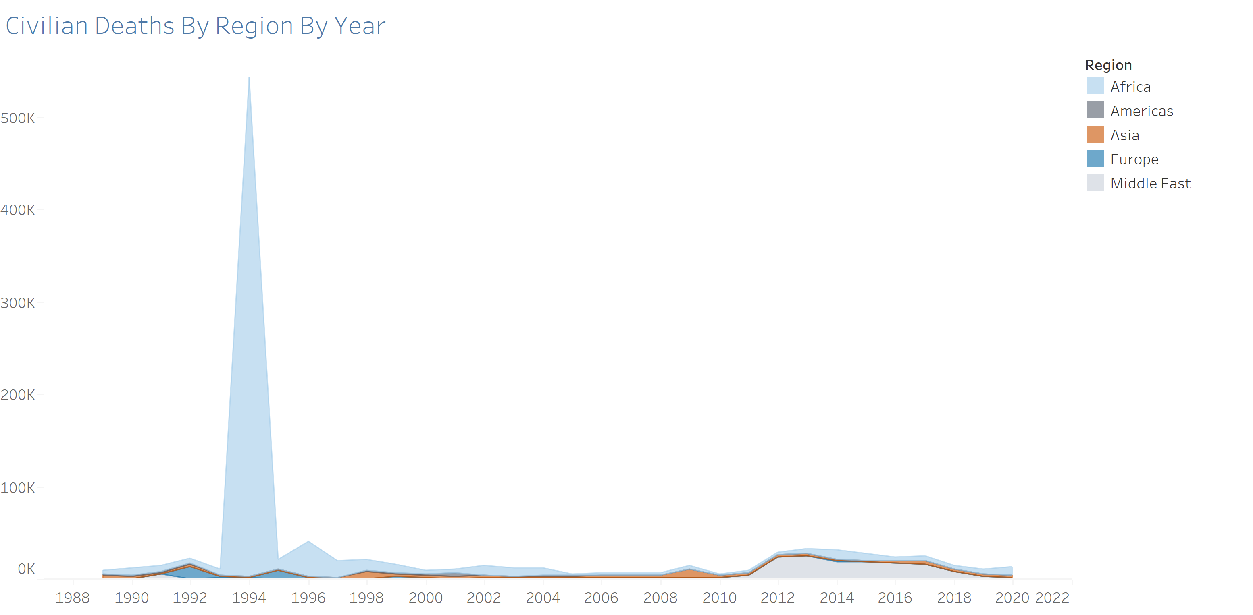

Slide 5
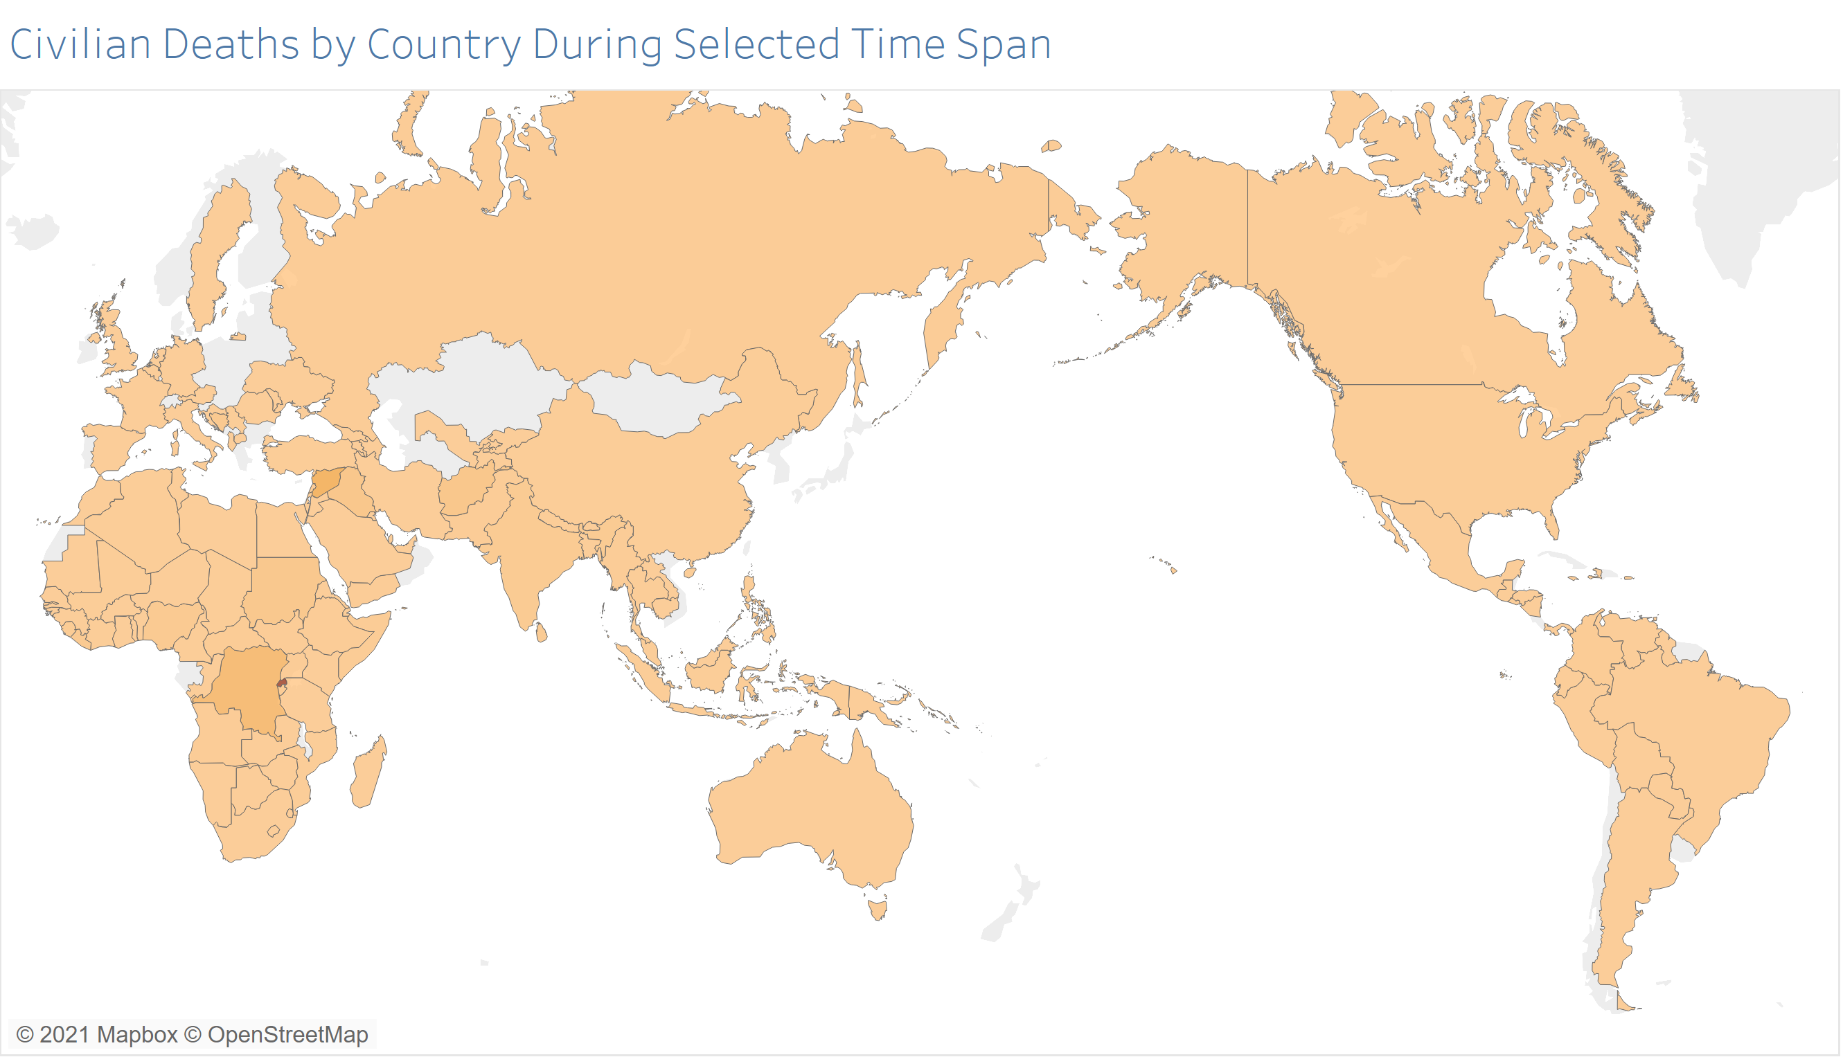

Slide 6
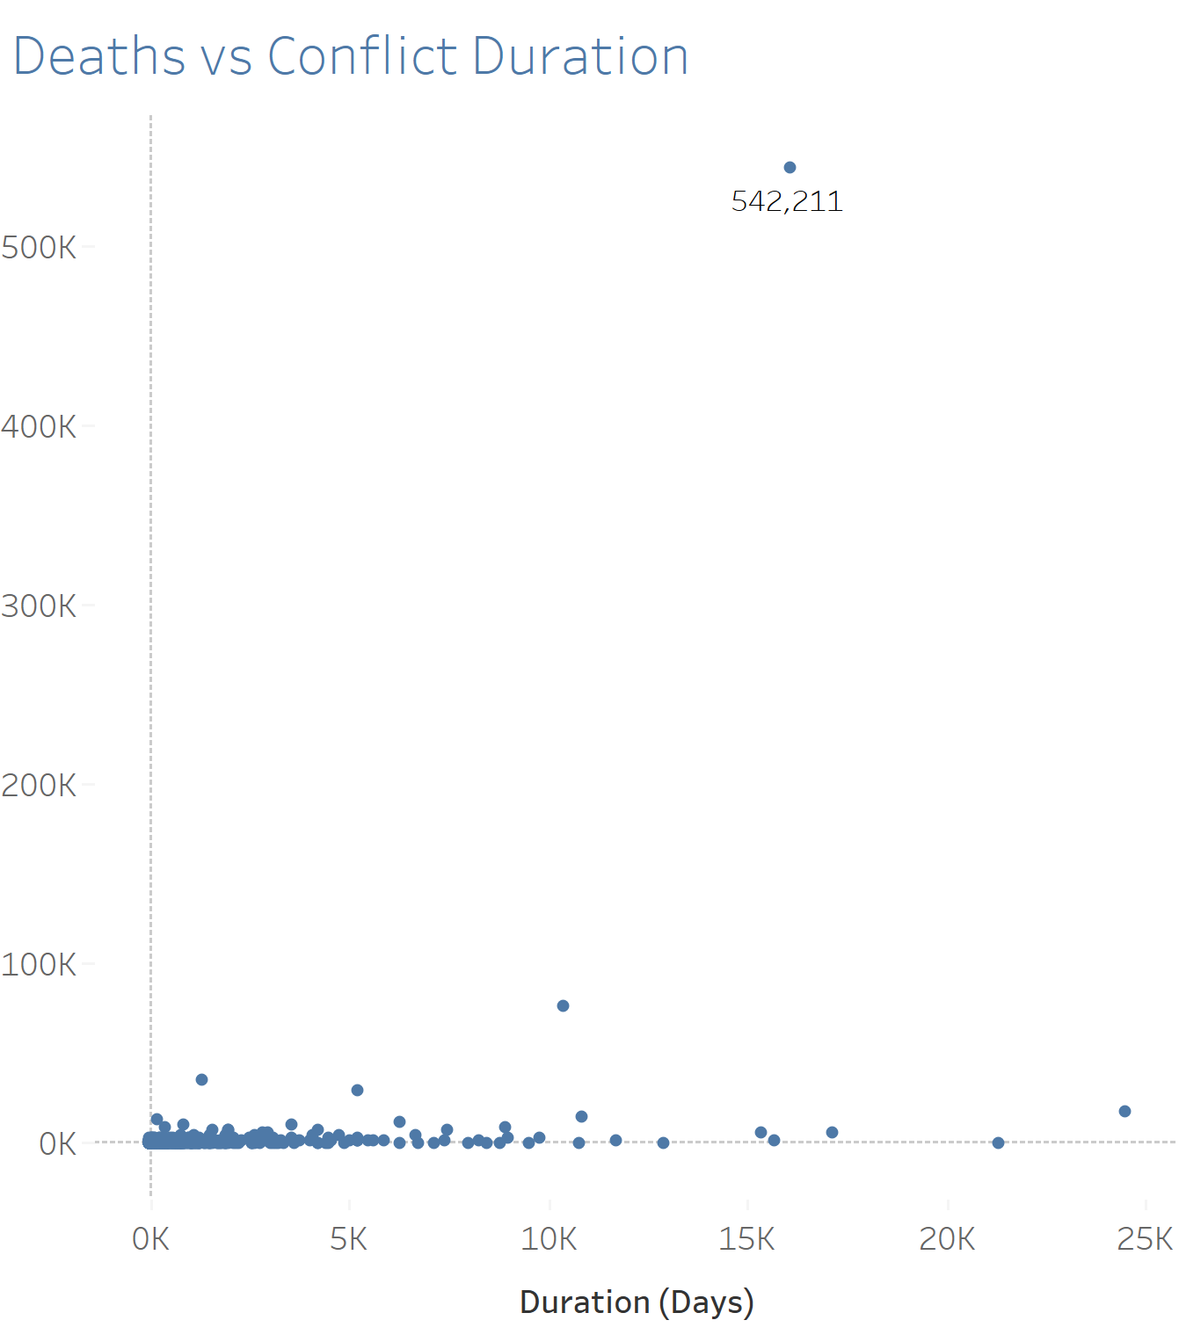

Slide 7
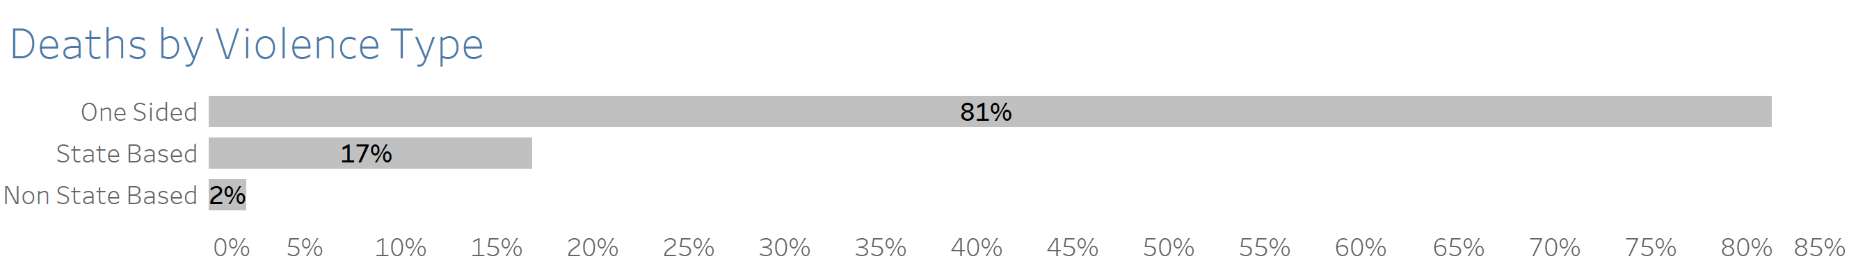

Slide 8
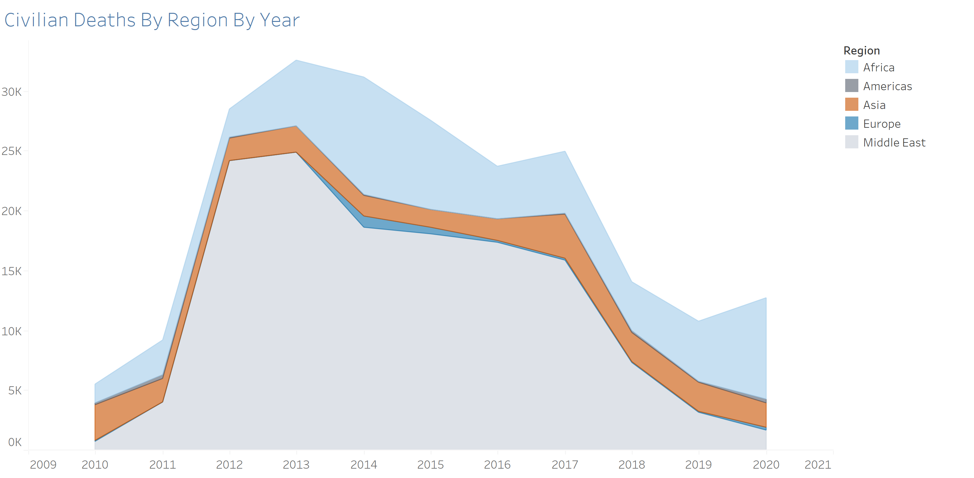

Slide 9
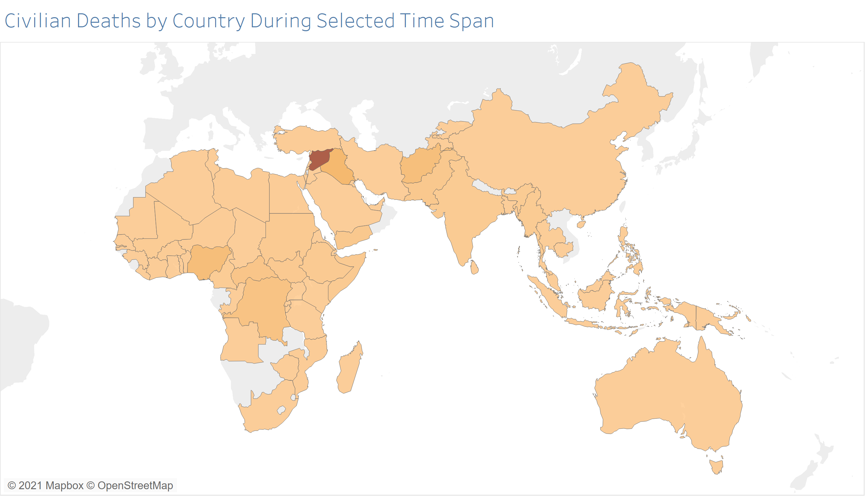

Slide 10
Further Resources
https://watson.brown.edu/costsofwar/costs/human
https://www.cmu.edu/chrs/index.html
https://civiliansinconflict.org/

